Slide 1
Social Sector Commissioning
Community Networks Wellington – February 2023

Slide 2
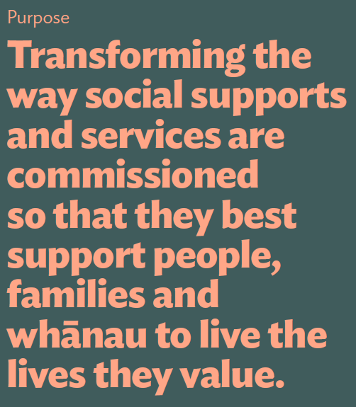

Slide 3
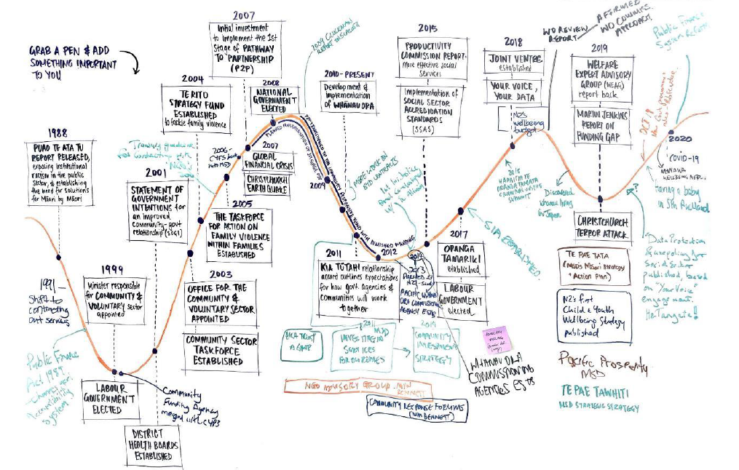
Looking back...

Slide 4
What type of supports and services are in scope?
Social suppports and services available to individuals, families and whānau that lead to improved wellbeing.
These supports and services might span across welfare, housing, health, education, child and youth, justice.
Government
national, regional, or local government departments, Crown entities
Non-government
non-government organisations, community organisations and philanthropic organisations
Iwi/hapu, Urban Māori Authority
Through iwi trusts and affiliated kaupapa Māori organisations
Government funded and delivered supports and services
Commissioned social supports and services
Funded by government
Delivered through non-government organisations (for profit and not for profit) and/or iwi, hapū trust or affiliated organisations
Commissioned social supports and services
Funded by a collection of government funding, philanthropy, organisational fundraising,
Delivered through non-government organisations (for profit and not for profit) and/or iwi, hapū trust or affiliated organisations
Non-government or iwi trust funded and delivered supports and services and/or iwi trust or affliated organisations
Philanthropic funded supported supports and services delivered by the sector
Government grants issued to community organisations
The portion of supports and services we’re focused on in this work

Slide 5

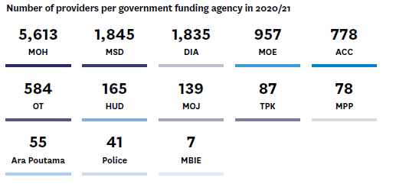

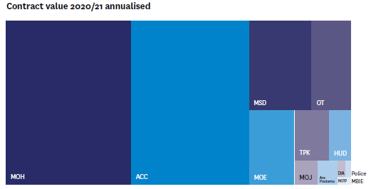
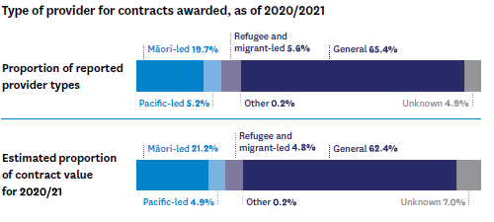
What funding does the government provide?

Slide 6
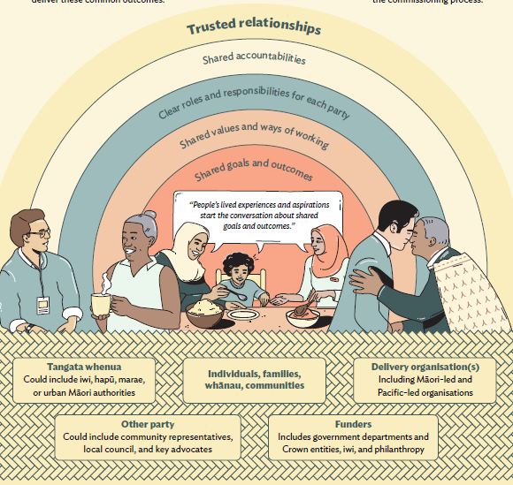
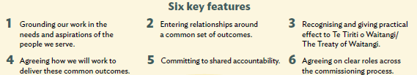
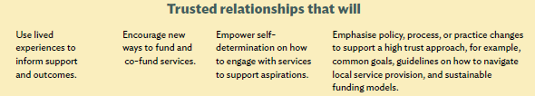
A relational approach to commissioning

Slide 7


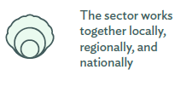




A relational approach to commissioning
A set of principles underpins a relational approach to commissioning
This includes the individuals, families and whānau being supported, tangata whenua, non-government and community organisations, the philanthropic sector, and government agencies.
The principles are interdependent, equally valuable, and indivisible. They should also complement and enable Te Tiriti o Waitangi/The Treaty of Waitangi-led commissioning through the emphasis on building trusted, meaningful relationships centred on the lived experiences and interests of individuals, families, whānau, and communities.

Slide 8
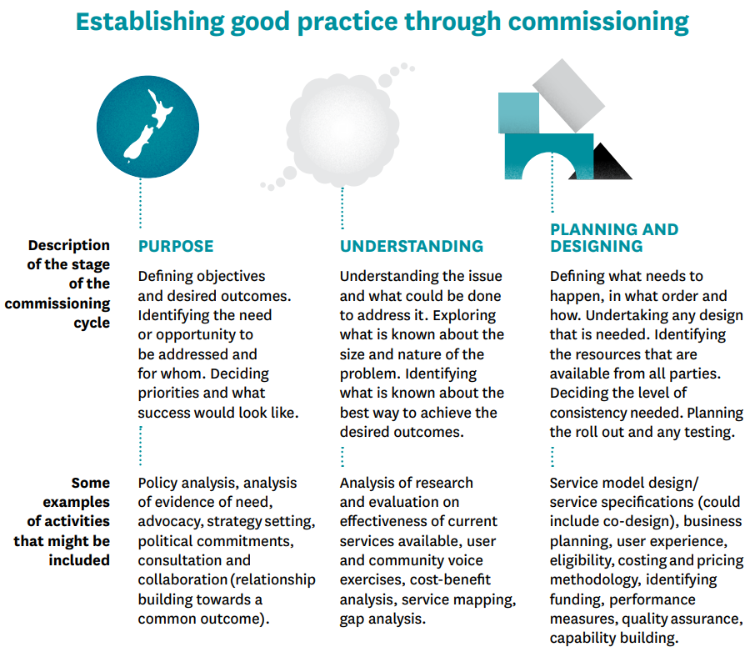
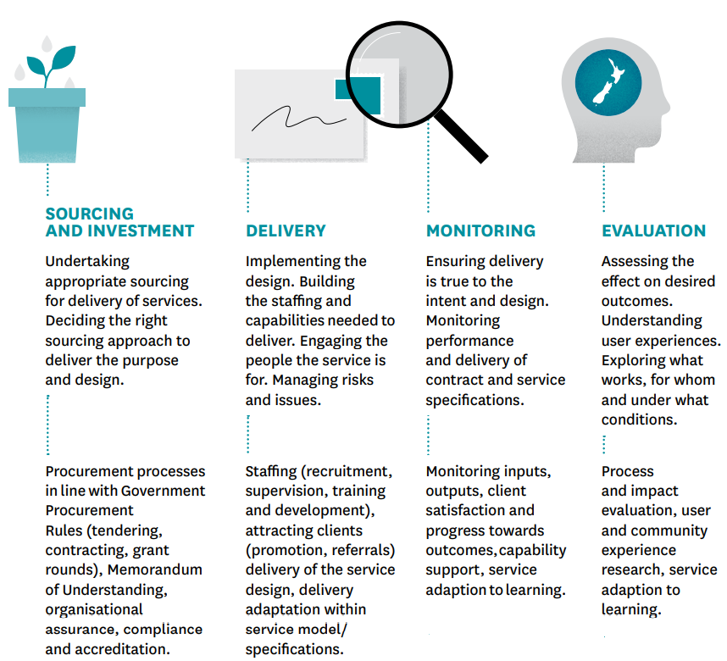
A relational approach to commissioning
A relational approach to commissioning is a pre-condition to an effective way to undertake any commissioning activity

